Slide 1
Browsing History Analysis Presentation🔍

Slide 2
1️⃣ Introduction
This analysis explores anonymized browsing history data.
The goal is to uncover user behavior trends and present actionable insights.
The dataset includes information about visited websites, timestamps, and browsing transitions.

Slide 3
2️⃣ Data Cleaning & Preparation
Handling Missing Values: Removed null values from event timestamps and visit-related columns.
Date/Time Conversion: Extracted hours and days of the week from timestamps for time-based analysis.
Duplicate Removal: Ensured each browsing session is unique.

Slide 4
3️⃣ Exploratory Data Analysis & Insights
📊 1. Top 10 Most Visited Websites
Observation: The most visited websites include social media, news, and shopping platforms.
Insight: Users prefer a few specific platforms, indicating a strong engagement pattern.

Slide 5
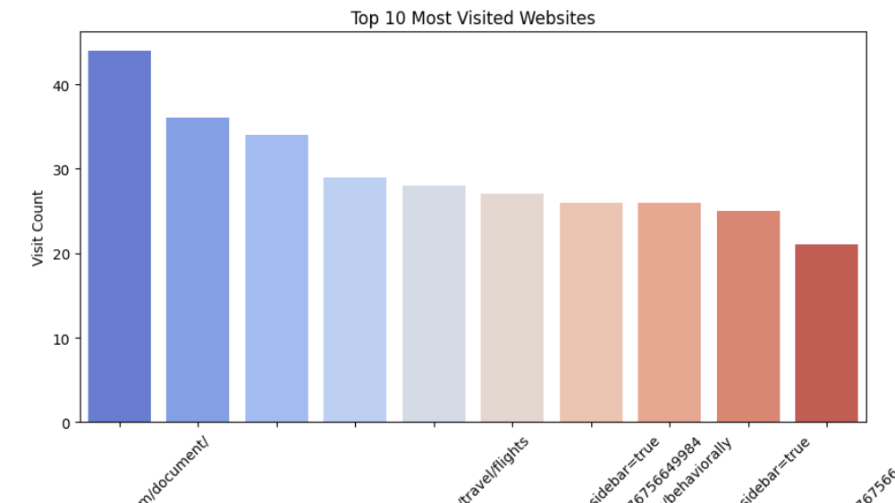

Slide 6
📈 2. Browsing Activity by Hour
Observation: Peak browsing hours occur between 6 PM and 10 PM.
Insight: Users are more active in the evening, suggesting better engagement opportunities during these hours.

Slide 7
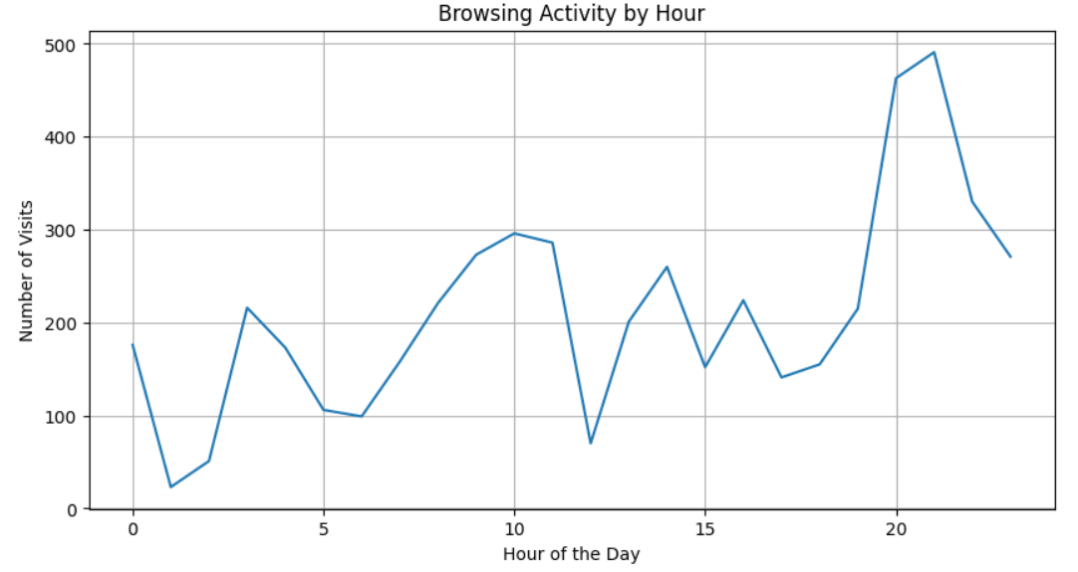

Slide 8
📅 3. Browsing Activity by Day of the Week
Observation: Browsing activity is highest on weekends.
Insight: Users tend to browse more for entertainment and leisure on non-working days.

Slide 9
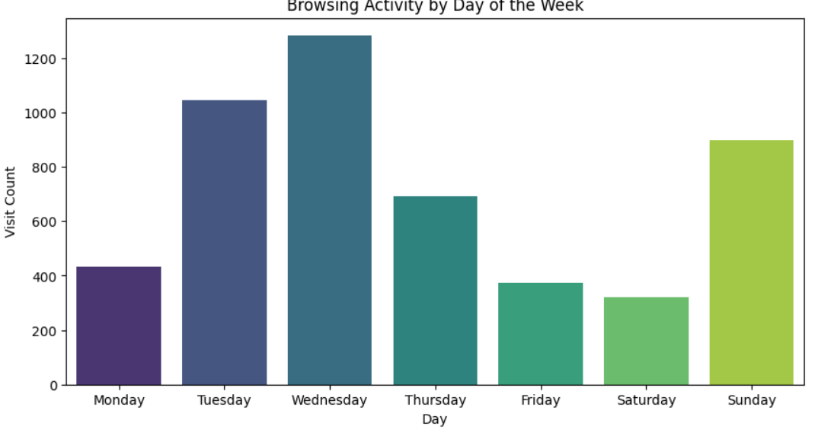

Slide 10
🔄 4. User Flow Analysis (Visit vs. Referring Visit)
Observation: A significant number of visits come from direct URLs and internal page navigation.
Insight: Understanding user flow helps in optimizing website structure and internal linking strategies.

Slide 11
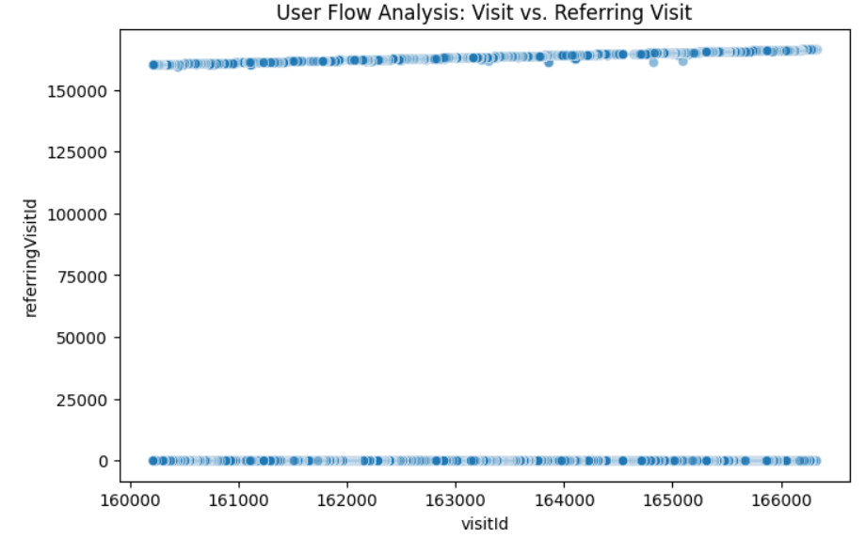

Slide 12
📊 5. Website Transition Type Distribution
Observation: Most visits occur through link clicks, followed by direct entry.
Insight: Websites relying on external referrals should focus on improving organic traffic sources.

Slide 13
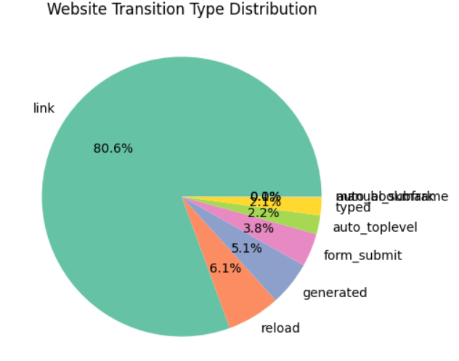

Slide 14
4️⃣ Conclusion & Recommendations
Peak browsing hours (6 PM - 10 PM) should be targeted for content publishing.
Weekends have the highest browsing activity, ideal for marketing and engagement.
Websites should optimize their internal linking strategies based on user flow.
Transition analysis can help businesses improve external traffic acquisition.

Slide 15
🚀 This presentation provides data-driven insights to improve user engagement and optimize browsing experiences.
THANK YOU😊
For Clear Visualizations: https://colab.research.google.com/drive/1-rtZ1GFzodWL0ohiYbv_VHAbFYUyLzSJ?usp=drive_link

